Slide 1
Digital Image Processing 图像信息处理
宋明黎
brooksong@zju.edu.cn
计算机学院
浙江大学
2023秋冬学期
Mingli Song
College of Computer Science, Zhejiang University
brooksong@zju.edu.cn
http://person.zju.edu.cn/msong/

Slide 2
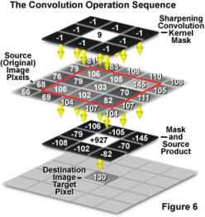
Basic operation (II)
Mingli Song
College of Computer Science, Zhejiang University
brooksong@zju.edu.cn
http://person.zju.edu.cn/msong

Slide 3
Histogram transform
Histogram transform: 3) Color quantization
s
s
255
255
214
176
20
r
r
0
0
48
134
255
48
142
255

Slide 4
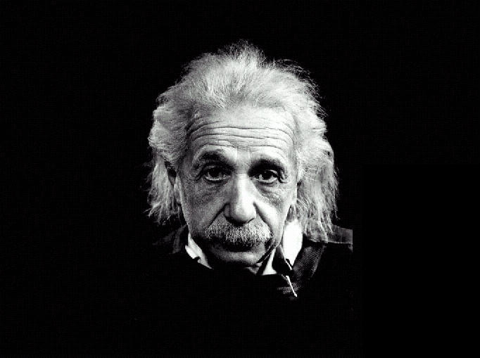
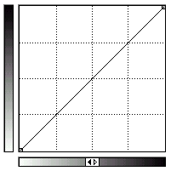
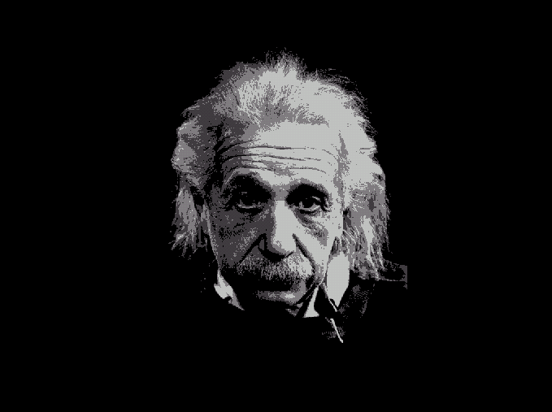
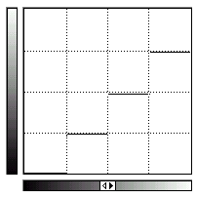
Histogram transform
Histogram transform: 3) Color quantization

Slide 5
Histogram transform
Histogram transforms
Linear transform
Nonlinear Transform
Notes:
根据变换函数类型的不同，直方图灰度变换可以分为线性变换和非线性变换两大类。

Slide 6
Linear histogram transform
Linear grayscale transform
M-1
s=kr+b
s
b
0
r
L-1

Slide 7
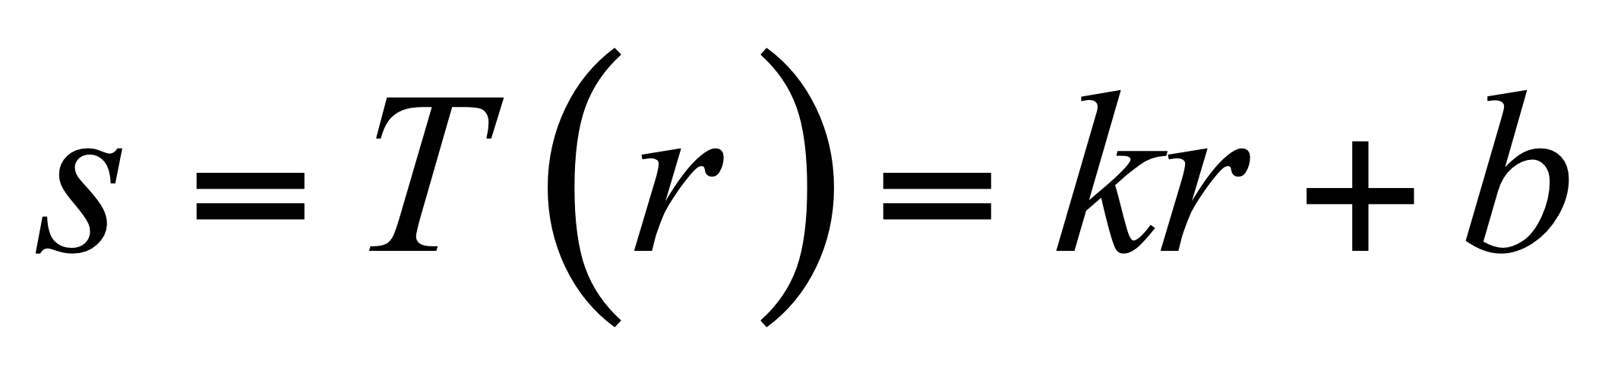
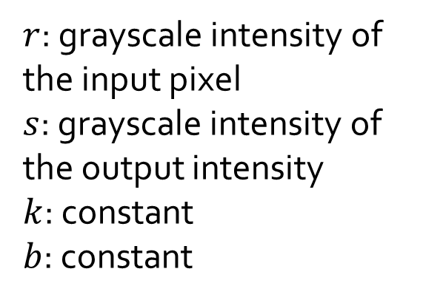
Linear histogram transform
Linear grayscale transform
M-1
s=kr+b
s
b
0
r
L-1
Notes:
其中，r为输入点的灰度值，s为相应输出点的灰度值，k、b为常数。

Slide 8
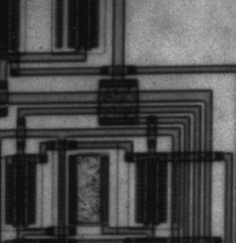
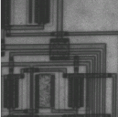
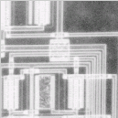
Linear histogram transform
Linear grayscale transform--Example
Original image
After transform
Inversed result
1
1
s=kr+b
s=kr+b
0.5
0.5
0
0
0.5
1
0.5
1

Slide 9
Linear histogram transform
Linear grayscale transform—Contrast stretching
g(x,y)
d
c
0
a
b
f(x,y)

Slide 10
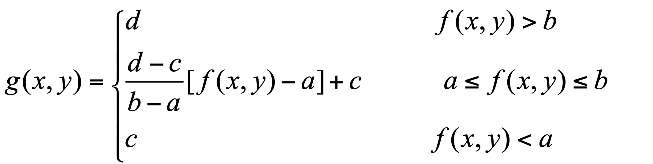

Linear histogram transform
Linear grayscale transform—Contrast stretching
g(x,y)
d
c
f(x,y)
0
a
b
Notes:
输入图像f(x,y)灰度范围为[a,b]
输出图像g(x,y)灰度范围为[c,d]

Slide 11
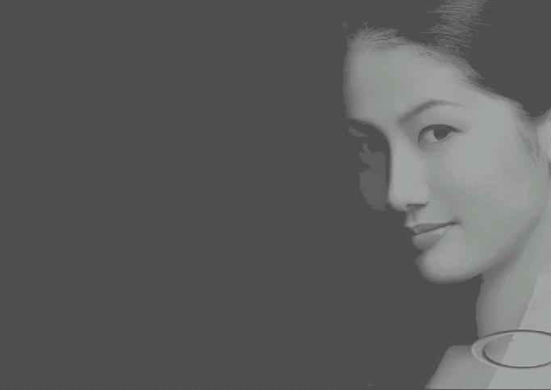
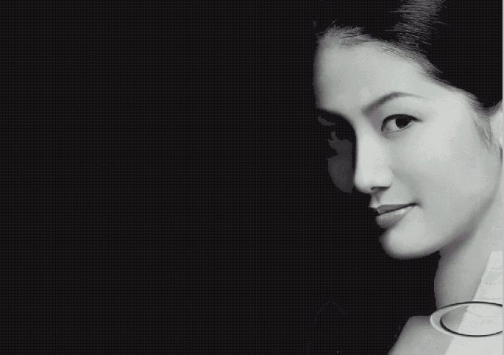

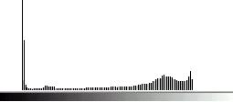
Linear histogram transform
Linear grayscale transform—Contrast stretching
(a) Original image and its histogram (b) Contrast stretched image and its histogram

Slide 12



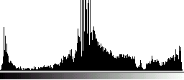
Linear histogram transform
Linear grayscale transform—Contrast stretching
(c)
(a)
(b)
(d)
(a)Original image，(b) Contrast stretched image, (c) and (d) are the corresponding histogram

Slide 13
Linear histogram transform
Piecewise linear grayscale transform
Linear grayscale transform by using a piecewise function, which strengthen the region of interest, weaken the region of no-interest.
Notes:
利用分段直方图变换，可以将感兴趣的灰度范围线性扩展，同时相对抑制不感兴趣的灰度区域。

Slide 14
Linear histogram transform
Piecewise linear grayscale transform
g(x,y)
M_{g}
d
c
f(x,y)
0
a
b
M_{f}

Slide 15
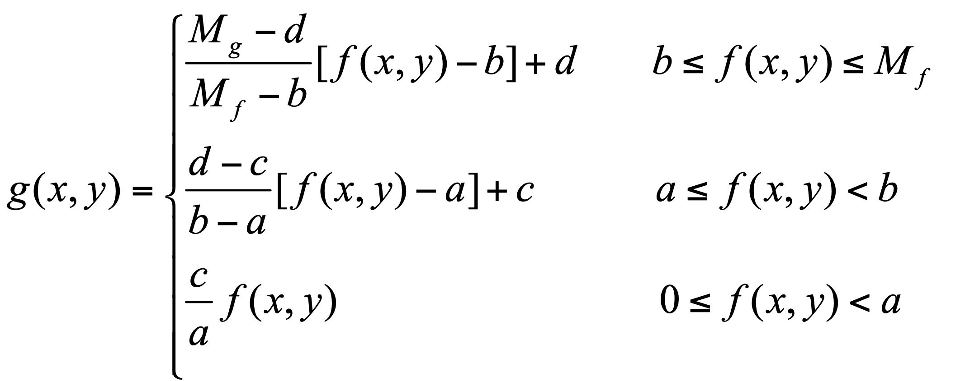
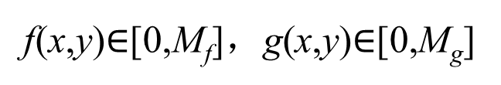
Linear histogram transform
Piecewise linear grayscale transform
g(x,y)
M_{g}
d
c
f(x,y)
0
a
b
M_{f}

Slide 16
Nonlinear histogram transform
Histogram transform by a nonlinear function
Logarithmic function and Exponential function are two popular nonlinear transform functions.

Slide 17
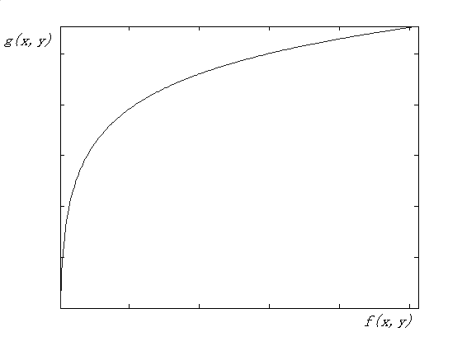
Nonlinear histogram transform
Logarithmic transform
Stretch low grayscale region
Compress high grayscale region

Slide 18
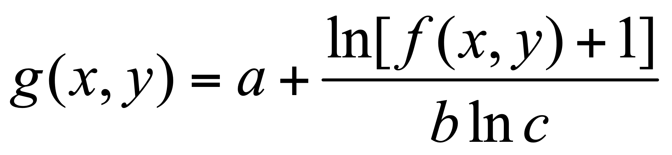
Nonlinear histogram transform
Logarithmic transform
a,b,c are all adjustable

Slide 19
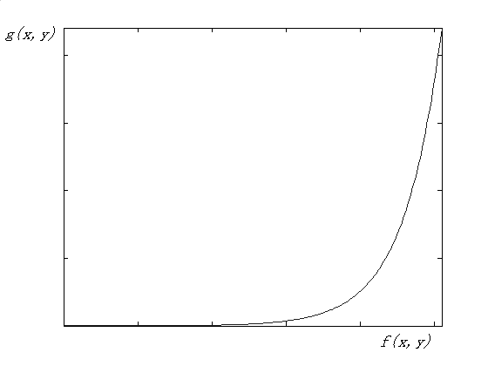
Nonlinear histogram transform
2．Exponential transform
Stretch high grayscale region
Compress low grayscale region

Slide 20
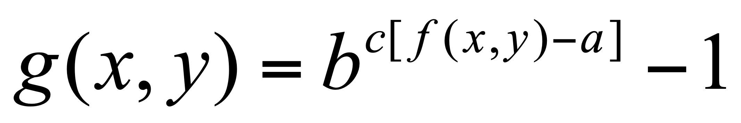
Nonlinear histogram transform
Exponential transform
a,b,c are all adjustable

Slide 21
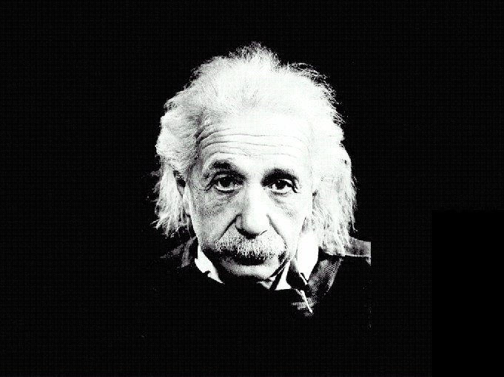
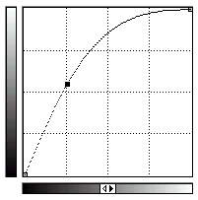
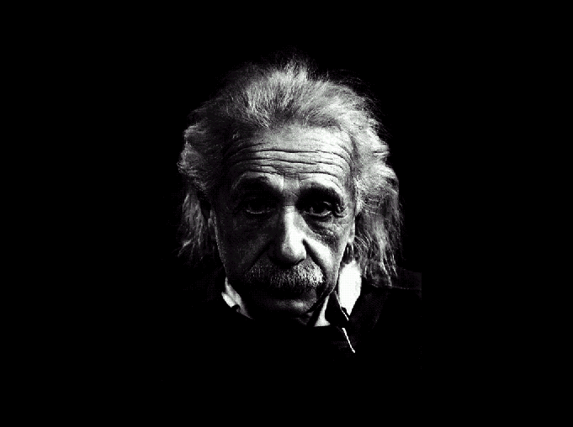
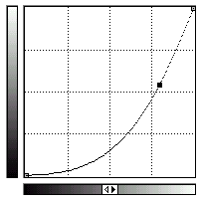
Nonlinear histogram transform
Logarithmic transform and exponential transform
A | B
 | C
A：original image
B：Logarithmic
C：Exponential

Slide 22
Assignment-3
1. Image logarithmic operation for visibility enhancement
2. Histogram equalization
Notes:
1.图像可视性对数增强
2.直方图
3.直方图均衡化

Slide 23
Basic operation (III)
Mingli Song
College of Computer Science, Zhejiang University
brooksong@zju.edu.cn
http://person.zju.edu.cn/msong

Slide 24
Geometric transform
1 Simple geometric transform
2 Interpolation
3 Warp and morph
4 Application

Slide 25
Geometric transformation
Concept
Produce a new image by changing the location of pixel through transformation.
Does NOT change pixel value, but change the pixel location.
Notes:
利用变换函数改变图像中像素的位置，从而产生新图像的过程。
几何变换不改变像素值，而是改变像素所在的位置。

Slide 26
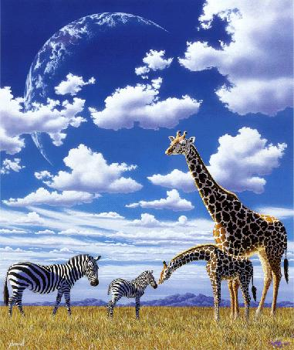
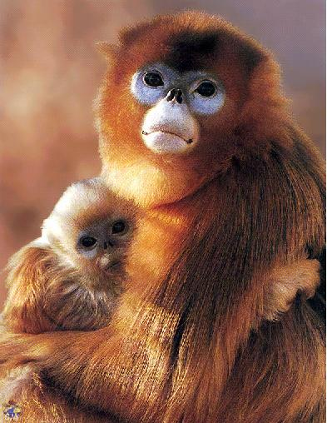
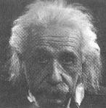
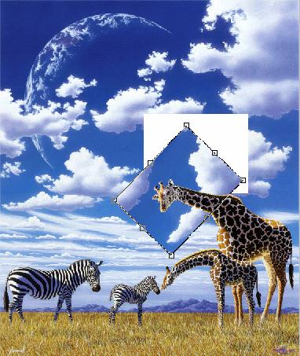
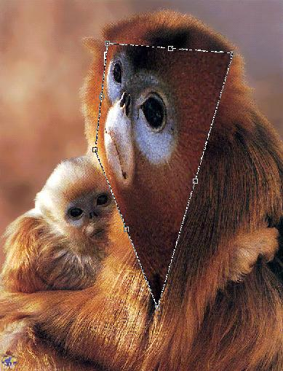
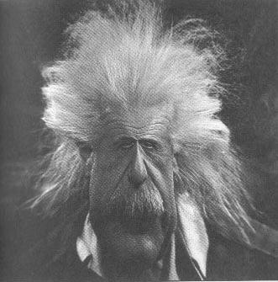
Geometric transformation
Examples
(a)
Original
(b)
After geometric transformation

Slide 27

Geometric transformation
Example

Slide 28
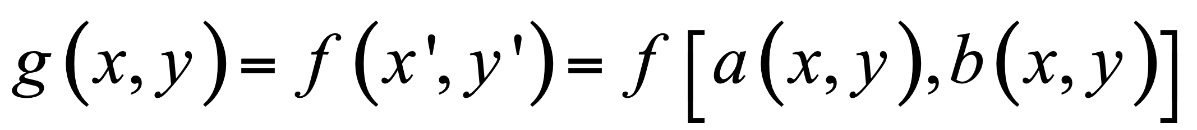
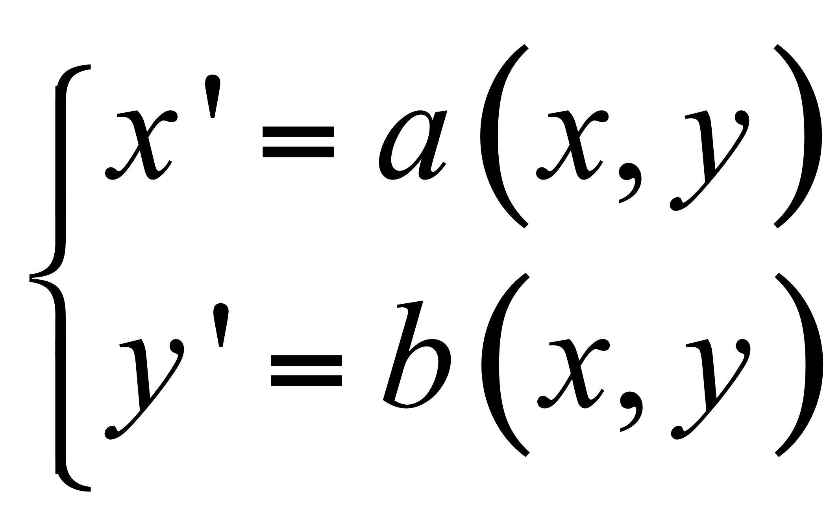
Geometric transformation
Equation
OR
f(x,y): input image;
g(x,y): output image;
a(x,y), b(x,y): describe the spatial transformation
Notes:
f(x,y)表示输入图像， g(x,y)表示输出图像。函数a(x,y)和b(x,y)唯一地描述了空间变换。

Slide 29
Geometric transformation
Two types:
1）Simple transformation——the procedure of transformation (the pixel location before and after transformation) is known, e.g., translation, mirror, transpose, rotation, scale, shear, etc.
2）General transformation——the procedure of transformation is complex. It’s difficult to measure the transformation parameters. Usually, general transformation will be employed when people fix the image distortion.
Notes:
几何变换根据难易程度通常可以归结为两类：
1）简单变换——变换过程（各个像素变换前后的位置）以及变换参数可知时的变换，如图像的平移、镜像、转置、旋转、缩放、错切变换等。
2）一般变换——变换过程不是一目了然，变换参数难以测量时的变换。通常情况下，对图像畸变进行校正时，需要用到较为复杂的变换公式。

Slide 30
Simple geometric transformation
Translation
Translate all the pixels in an image vertically and horizontally to produce a new image.
Notes:
将图像沿水平和竖直方向移动，从而产生新图像的过程。

Slide 31
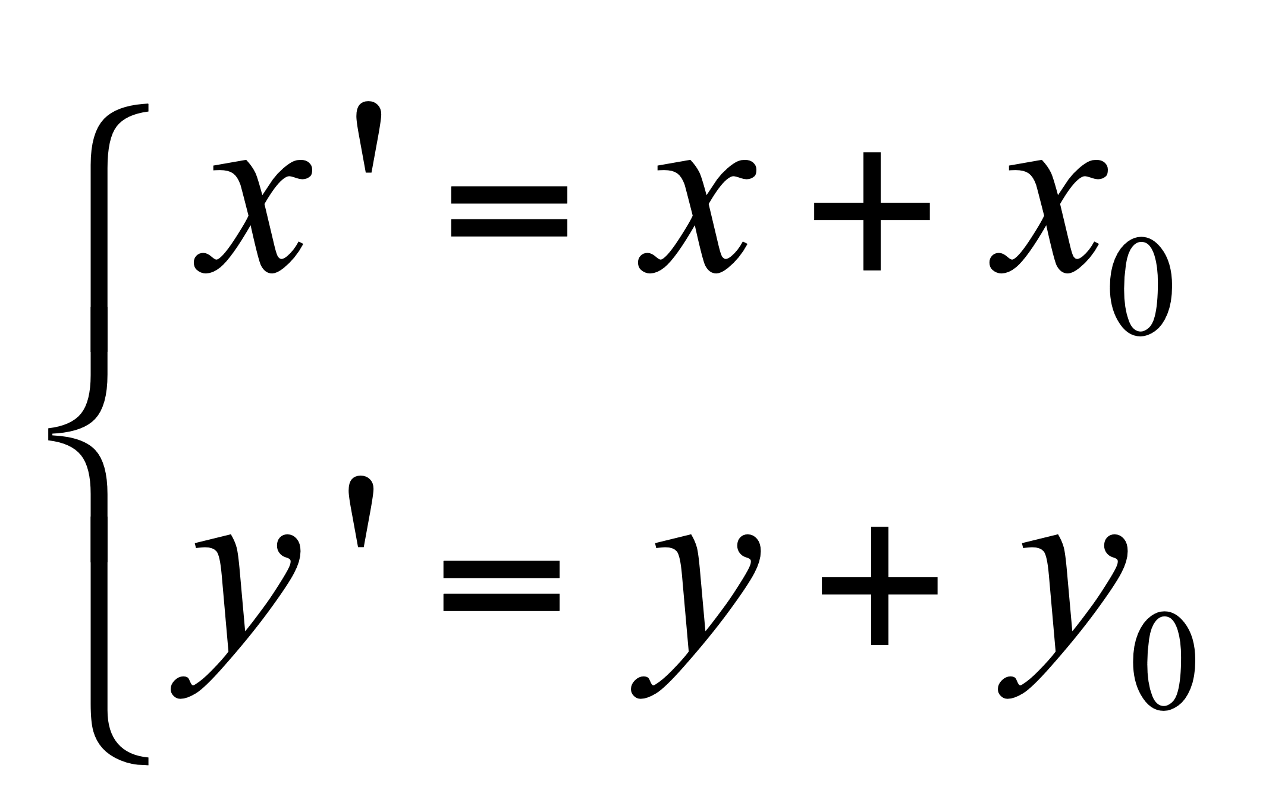
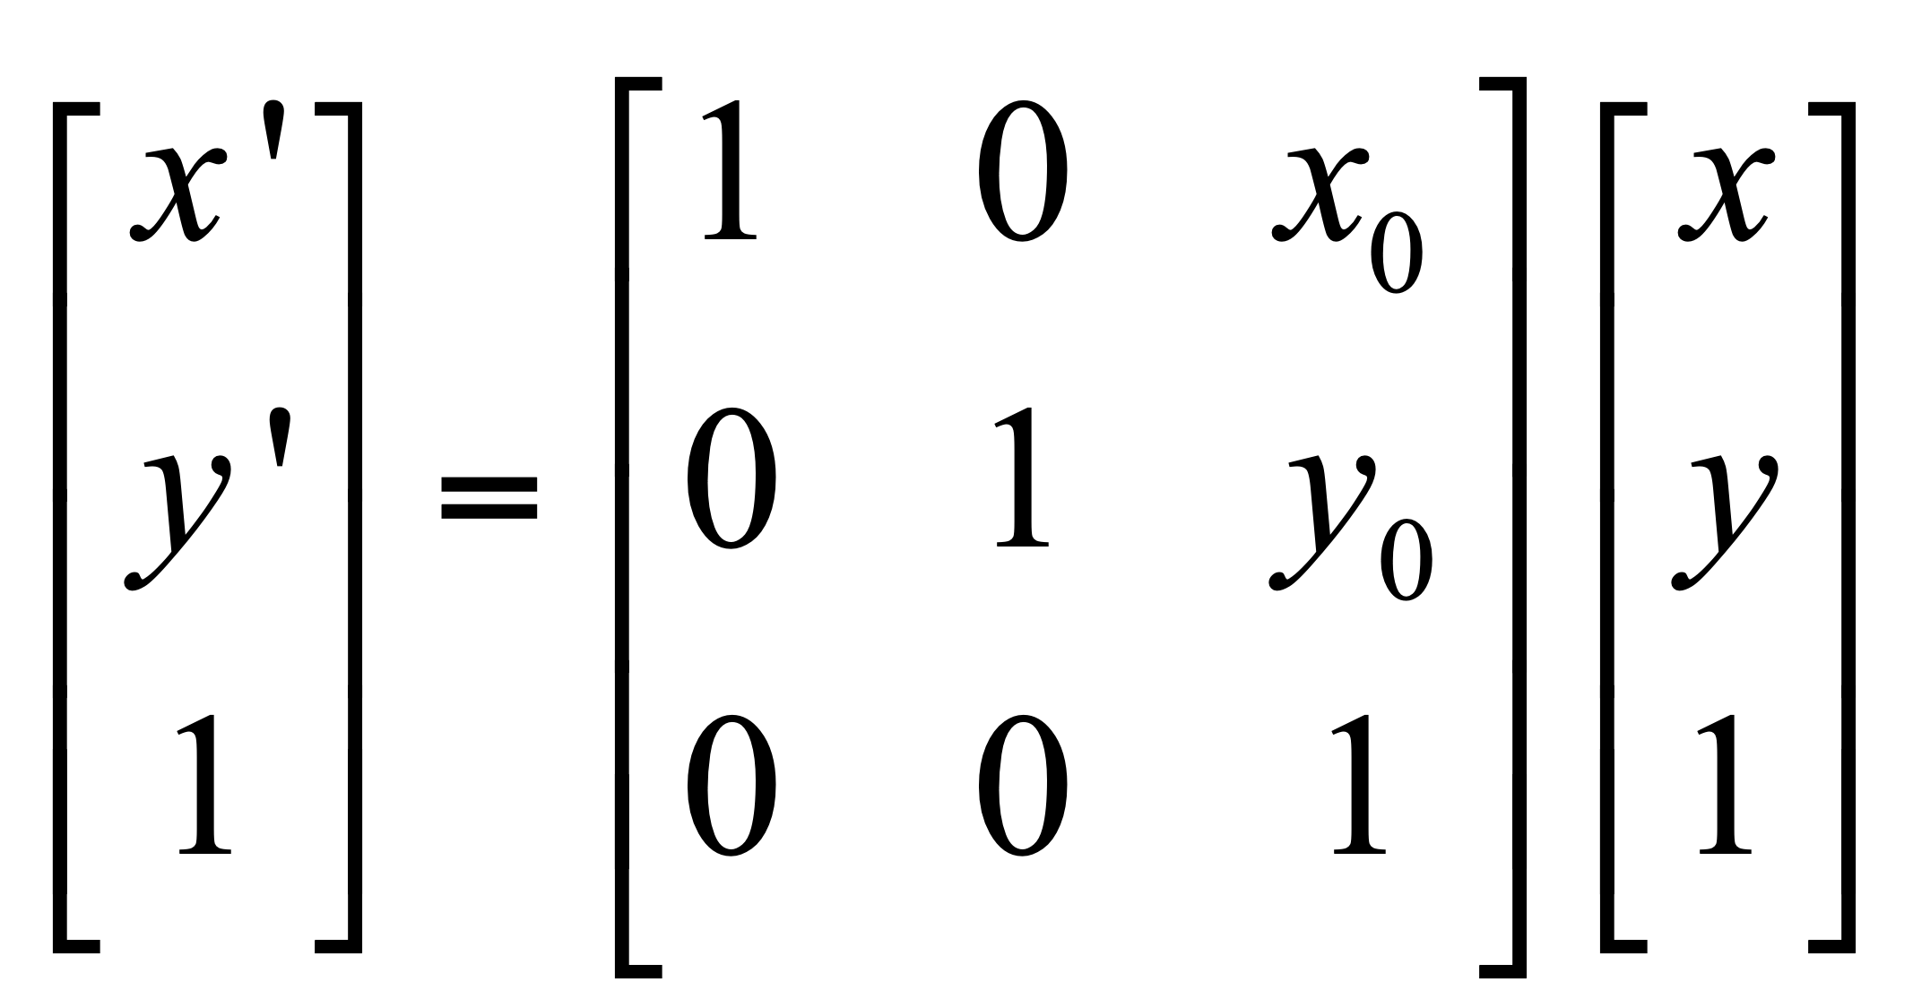
Simple geometric transformation
Translation——Equation
OR
Notes:
原图像中的每个像素沿x方向平移x₀，沿y方向平移y₀。

Slide 32
Simple geometric transformation
Translation——Example
x₀=1，y₀=2
y
x
(a) Original
(b) After translation

Slide 33
Simple geometric transformation
Translation——Explanation
The image after translation is same as the one before translation, but the “canvas” should be enlarged, or the visual information will be lost.
Notes:
平移后的景物与原图像相同，但“画布”一定是扩大了，否则就会丢失信息。

Slide 34
Simple geometric transformation
Mirror——Concept
flip around x axis or y axis, and produce a new image symmetric to the original one.
Notes:
绕x轴或y轴翻转，从而产生与原图像对称的新图像的过程。
绕x轴或y轴翻转，从而产生与原图像对称的新图像的过程。

Slide 35
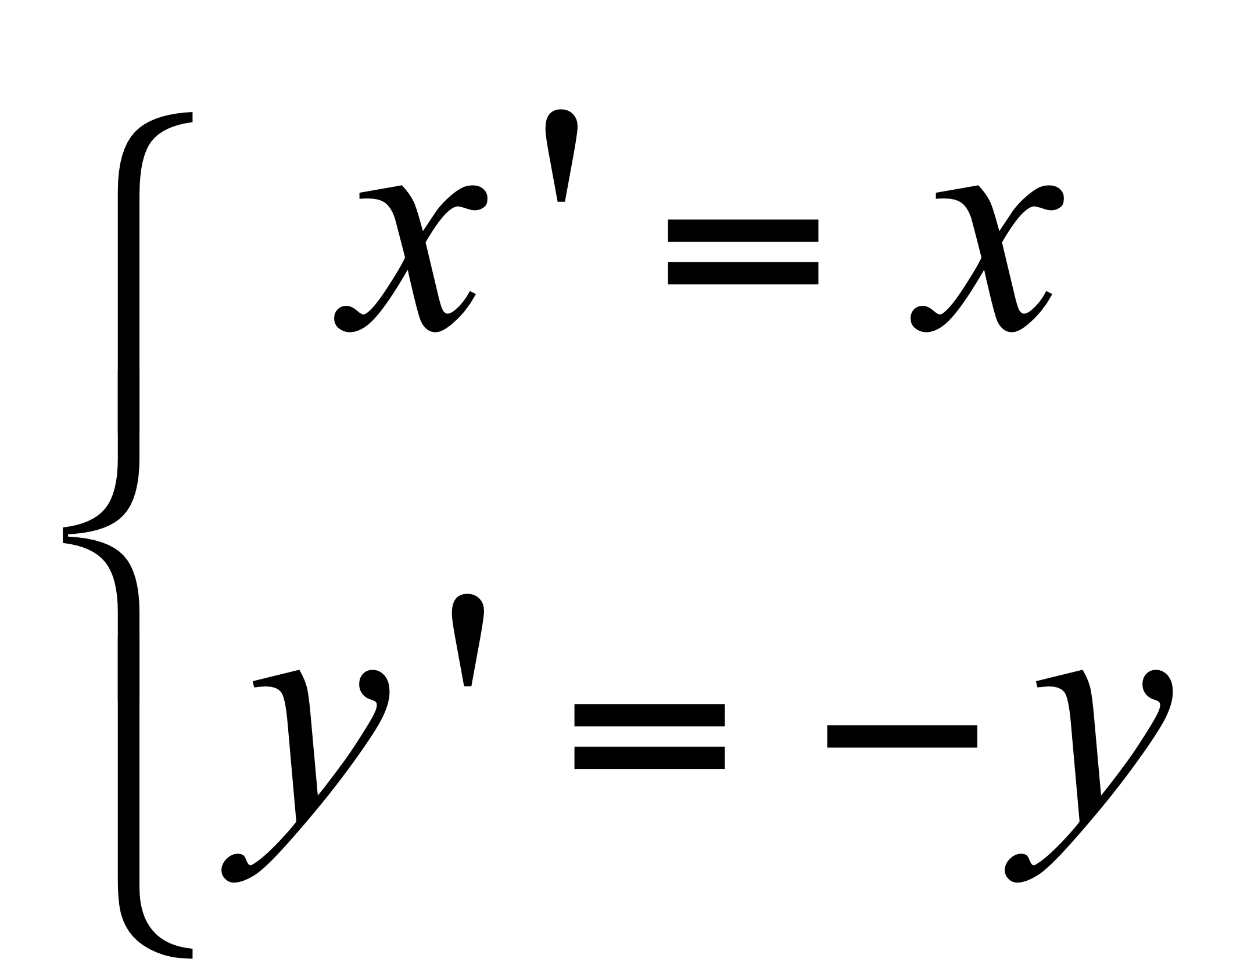
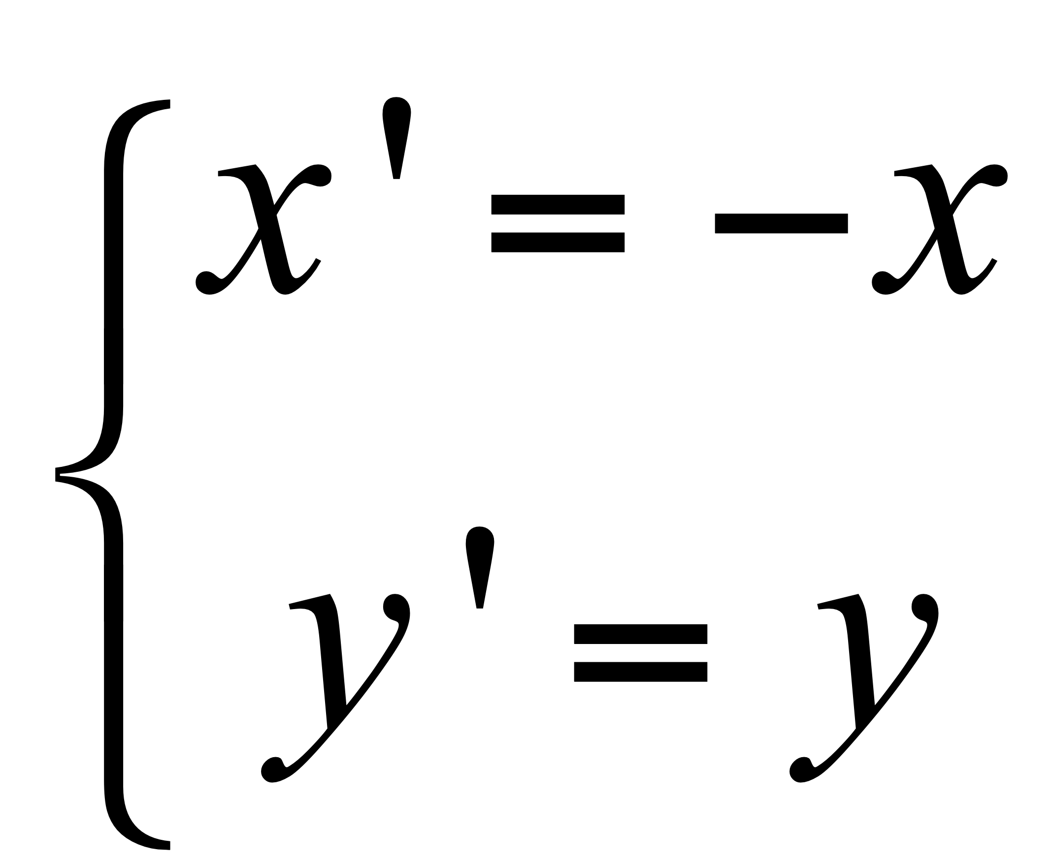
Simple geometric transformation
Mirror——Equation
Flip around x axis:
Flip around y axis:

Slide 36
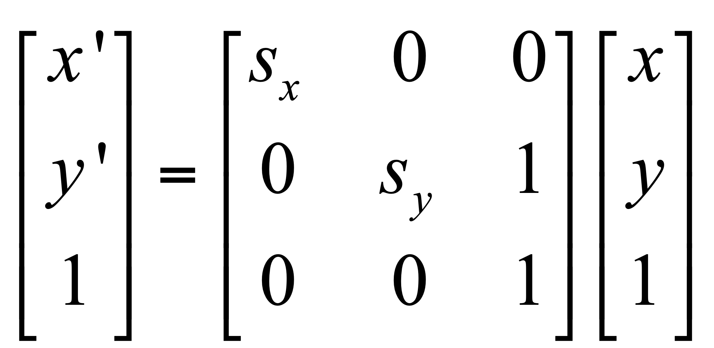
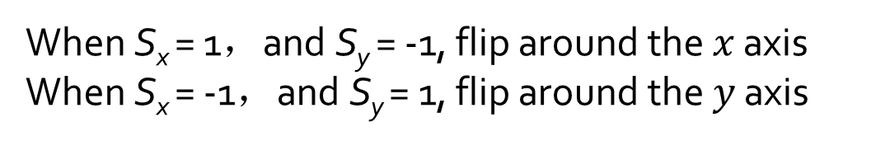
Simple geometric transformation
Mirror——Equation
Notes:
当S_{x} = 1，且S_{y} = -1时实现绕x轴的镜像变换
当S_{x} = -1，且S_{y} = 1时实现绕y轴的镜像变换

Slide 37
Simple geometric transformation
Mirror——Example
(a) Original
(b) Horizontal mirror
(c) Vertical mirror

Slide 38

Simple geometric transformation
Rotation——Concept
Notes:
绕原点旋转\theta角，得到新图像的过程

Slide 39
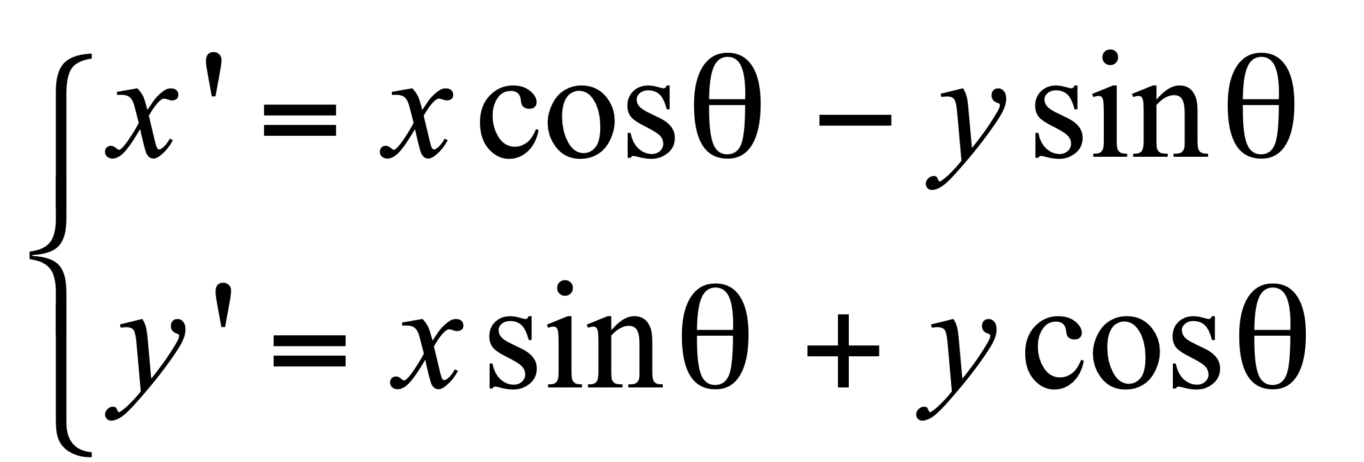
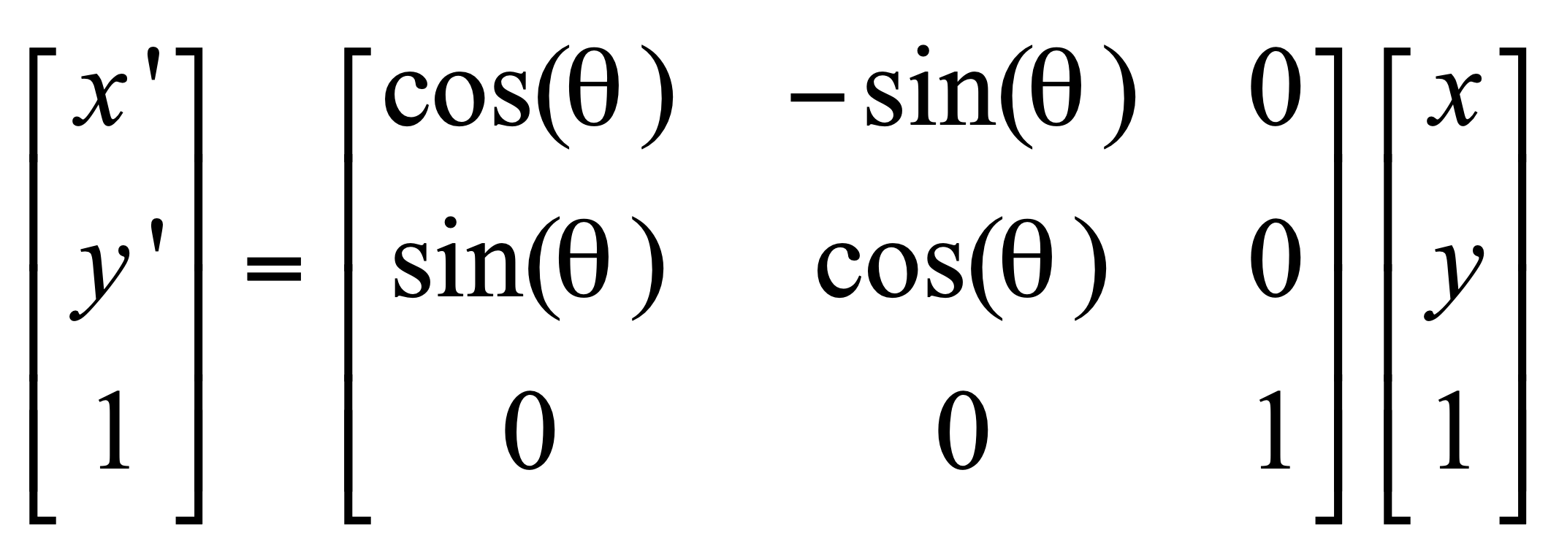
Simple geometric transformation
Rotation——Equation
OR

Slide 40
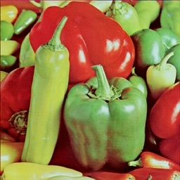
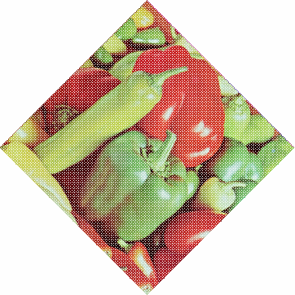
Simple geometric transformation
Rotation——hole problem
After rotation, there will be a lot of “holes” in the new image.
Notes:
空洞问题
图像经过旋转变换以后，新图像中会出现许多空洞

Slide 41
Simple geometric transformation
Rotation——“Hole”problem
Fill by “interpolation”
Row interpolation——find the holes in each row, and fill them with the intensity of the pixel before it in the row.
Notes:
用插值方法填补。
行插值——按顺序寻找每一行中的空洞像素，设置其像素值与同一行中前一个像素的像素值相同。

Slide 42
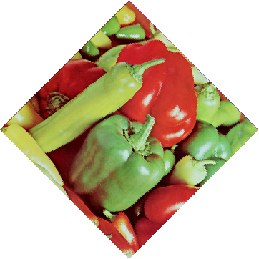
Simple geometric transformation
Rotation——“Hole” problem

Slide 43
Simple geometric transformation
Scale——Concept
Multiple the image with a coefficient to produce a new image.
Notes:
将图像乘以一定系数，从而产生新图像的过程。

Slide 44
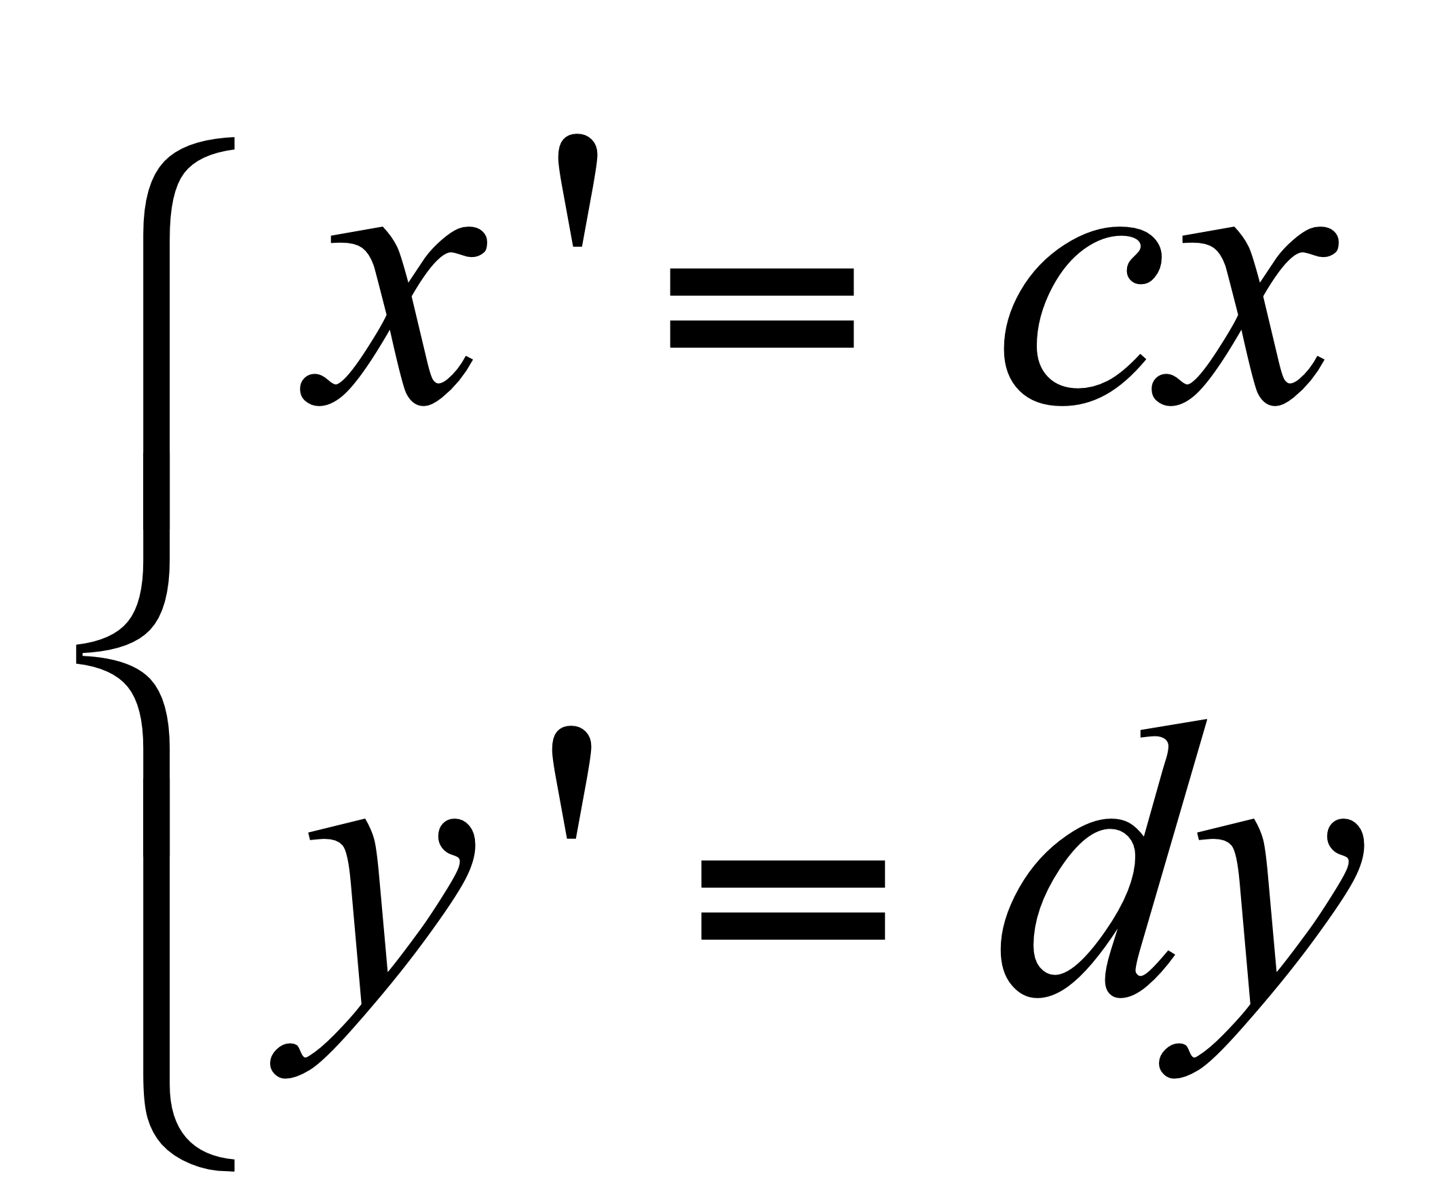
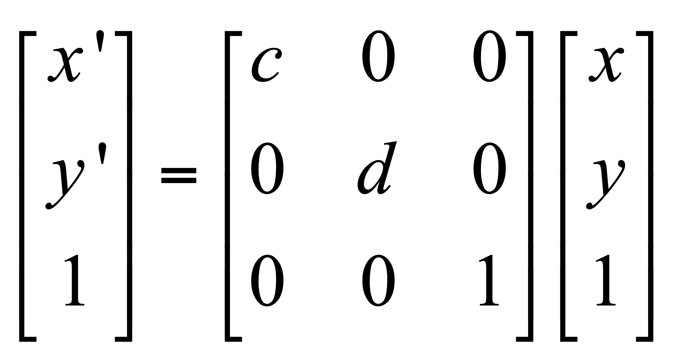
Simple geometric transformation
Scale——Equation
OR

Slide 45
Simple geometric transformation
Scale——Equation
Scale the image horizontally with coefficient c (enlarge when c>1, shrink when 0<c<1); scale the image vertically with coefficient d (enlarge when d>1, shrink when 0<d<1)
If c=d, the image is scaled with the same ratio. If NOT, the image is scaled horizontally and vertically with different ratios.
Shrink (down-sampling)——construct a new image by select pixels by predefined intervals from the original image.
Enlarge (a simple up-sampling)——there will be blank rows and columns. If you fill them by using interpolation, you will find some “mosaics” in the result.
Notes:
沿x轴方向缩放c倍（c>1时为放大，0<c<1时为缩小）；沿y轴方向缩放d倍（d>1时为放大，0<d<1时为缩小）。
当c=d时，图像等比缩放；否则为非等比缩放，导致图像变形。
缩小——按一定间隔选取某些行和列的像素构成缩小后的新图像；放大——新图像出现空行和空列，可采用插值的方法加以填补，但存在“马赛克”现象。

Slide 46

Simple geometric transformation
Scale——Example
(a) Original
(b) Scale with the same ratio
(b) Scale with different ratios
Image shrink

Slide 47


Simple geometric transformation
Scale——Example
(a) original
(b) Enlarge 8 times
Mosaics can be noticed

Slide 48
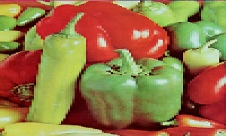

Simple geometric transformation
Scale——Example
(a) original
(b) After enlarge
Image enlargement

Slide 49
Simple geometric transformation
Shear——Concept
It is a non-vertical projection effect of the scene on the plane.
Notes:
图像的错切变换实际上是景物在平面上的非垂直投影效果。

Slide 50
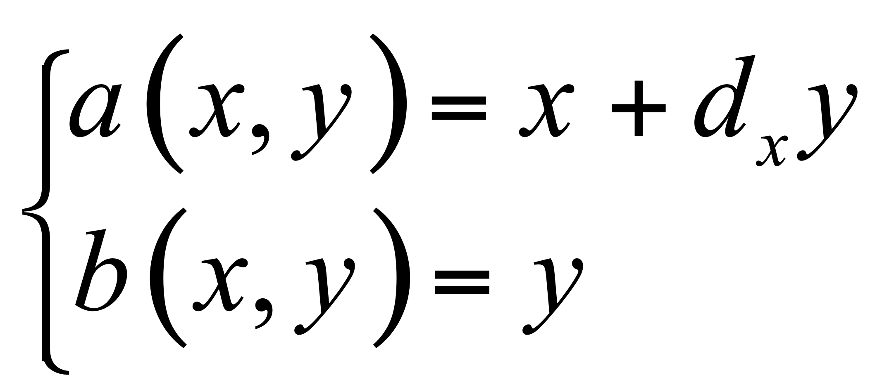
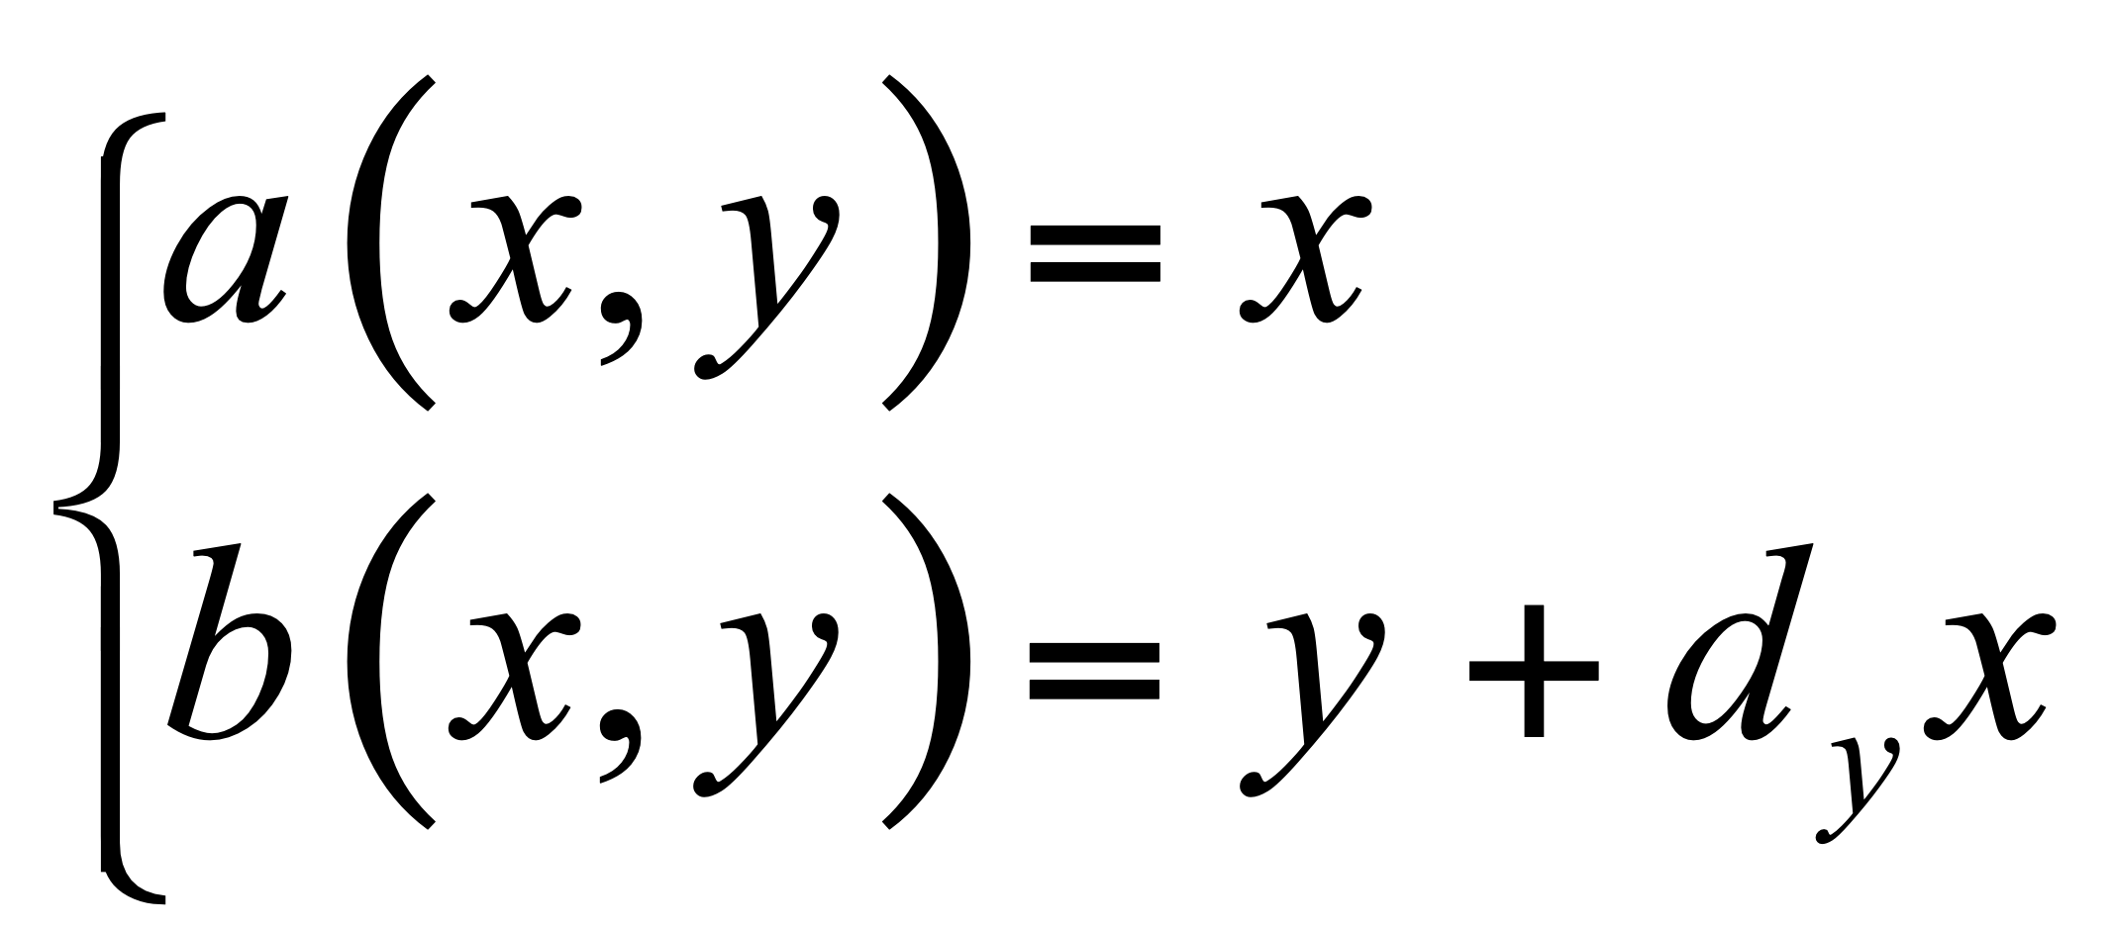
Simple geometric transformation
Shear——Equation
Shear on x axis
Shear on y axis
Notes:
沿x轴错切
沿y轴错切

Slide 51


Simple geometric transformation
Shear——Example

Slide 52

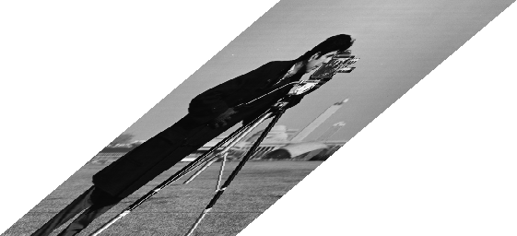
Simple geometric transformation
Shear——Example

Slide 53
Simple geometric transformation
Combination——Concept
Combine the simple geometric transformation together
Notes:
图像的组合变换是各项简单几何变换的混合操作。

Slide 54

Simple geometric transformation
Combination——Equation
Transformation matrix is obtained by taking into account all the simple geometric transformations.
Notes:
变换矩阵是由构成组合变换的各种简单变换的变换矩阵按从左至右的顺序逐次相乘以后得到的结果。
变换矩阵相乘时的顺序是不可以任意改变的

Slide 55
Interpolation
Interpolation is a typical tool for geometric transformation.
The interpolated pixel value can be obtained by using different interpolating methods.
Notes:
插值是几何变换最常用的工具，利用已知像素值，采用不同的插值方法，可以模拟出未知像素的像素值。

Slide 56
Interpolation
1. Nearest neighbor
2. Linear interpolation
3. RBF interpolation
Notes:
1. 最近邻插值
2. 线性插值
3. 径向基函数插值

Slide 57
Interpolation
Nearest neighbor based interpolation——Concept
The output pixel value equals to its nearest neighbor’s grayscale intensity.
Notes:
输出像素的灰度值等于离它所映射到的位置最近的输入像素的灰度值。

Slide 58
Interpolation
最近邻插值——计算过程
为了计算几何变换后新图像中某一点P’处的像素值，可以首先计算该几何变换的逆变换，计算出P’所对应的原图像中的位置P。通常情况下，P的位置不可能正好处在原图像的某一个像素位置上（即P点的坐标通常都不会正好是整数）。寻找与P点最接近的像素Q，把Q点的像素值作为新图像中P’点的像素值。

Slide 59

Interpolation
Nearest neighbor based interpolation——Computing process

Slide 60


Interpolation
Nearest neighbor based interpolation——limitation
The result cannot keep consistent and smooth when the image consists obvious geometric structures.
Notes:
当图像中包含明显的几何结构时，结果将不太光滑连续，从而在图像中产生人为的痕迹。

Slide 61



Interpolation
Linear interpolation——Equation (1D)
Notes:
在一维情况下，已知x₁和x₂处的灰度值分别为g₁和g₂，则x₃处的灰度值g₃为：

Slide 62


Interpolation
Linear interpolation——Equation (2D)
Notes:
在二维情况下，称为双线性插值。
已知图像的正方形网格上四个点A、B、C、D的灰度，求P点的灰度。

Slide 63

Interpolation
Linear interpolation——Equation (2D）
Notes:
定义双线性方程g(x,y)=ax+by+cxy+d 。
分别将A、B、C、D四点的位置和灰度代入方程，得到方程组。
解方程组，解出a、b、c、d四个系数。
将P点的位置代入方程，得到P点的灰度。

Slide 64

Interpolation
Result from bilinear interpolation

Slide 66


Interpolation
Radial Basis Function (RBF) based interpolation
Notes:
其中x可以是一个标量，也可以是一个向量，也就是说既可以是一维插值，也可以是二维、多维插值，取决于x的维度

Slide 67

Interpolation
RBF based interpolation
c1
c3
c2
x

Slide 68







Interpolation
A radial basis function (RBF) is a function based on a scalar radius.
Kernel functions available in RBF
Gaussian:
Multiquadrics:
Linear:
Cubic:
Thinplate:

Slide 69



Slide 70


Slide 72
Assignment 4
Simple geometric transformation
Translation
Rotation
Scale
Shear
Mirror
Notes:
图像的简单几何变换
平移
旋转
缩放
错切
镜像

Slide 73

Warp: only change the pixel’s location

Slide 74





Slide 75
Concept of Image Morph
Morph is not warp (geometric transformation)
Morph is a kind of morphological changing, which makes an image change to another image gradually.
Morph handles both the location and the intensity of a pixel.
The beginning image and end image are two key frames. Other frames between the two key frames are generated automatically.
Notes:
这里讨论的Morph变形不同于一般的几何变换(Warp)。
Morph变形指景物的形体变化，它是使一幅图像逐步变化到另一幅图像的处理方法。
这是一种较复杂的二维图像处理，需要对各像素点的颜色、位置作变换。
变形的起始图像和结束图像分别为两幅关键帧，从起始形状变化到结束形状的关键在于自动地生成中间形状，也即自动生成中间帧。

Slide 76

Morph
Notes:
大小相同的两幅图的转换作静态变换。从一幅图a逐渐变化成第二幅图b。
原理：让图a中每个像素的颜色，逐渐变成图b相同位置像素的颜色。
方法：根据变换的快慢，设置相应的步长，将图a每一点的RGB逐渐变成图b相同位置象素的RGB。可以选择等比或等差的方式，或其它方式让：rª-->r^{b}。
对于灰度图像，可以直接用等比或等差级数定义步长，使颜色从原图变到目标图。

Slide 77



Morph
Given a color image, RGB should be taken into account together.
Notes:
对于彩色图像，RGB三色同时从原图变到目标图像。可以分别变化，也可考虑RGB的相对比例关系同时变化。

Slide 78


$$I_{begin}$$
$$I_{end}$$

Slide 79







Slide 80

How to choose the key frames
The two key frames should be similar in structure and size, so as to obtain a natural and consistent morphing result.
Notes:
选择两幅结构相似、大小相同的画面作为起始和结束关键帧，这样才能比较容易地实现自然、连续的中间变形过程。

Slide 81

How to obtain the structure?
Label a series of feature points to define the structure of the beginning and end frame.
The feature points should keep correspondence.
Notes:
在起始和结束画面上确定和勾画出各部分（主要轮廓）的结构对应关系，也即从起始画面上的一个点变到结束画面上的另一个对应点的位置，这是变形运算所需要的参数。根据需要，对应点的位置可以任意移动。调整起始帧的对应点位置，可以模拟摄像中的镜头渐变效果。

Slide 82
Morph based on segment (two points)
After the feature points are determined, a series of segments are obtained.
If we want to morph segment A to be B, both the location and the color of each pixel in the image will change accordingly.
Notes:
在各点像素坐标变化的同时，每个像素的颜色RGB也一起从原图像改变为目标图像。

Slide 83
Different interpolation methods can be employed.
Notes:
这时可以采用不同的插值策略计算像素中间值（空间，颜色）

Slide 85


Example-morph based on feature points
Define the corresponding feature points between two images.
3
3
2
4
2
4
1
1
5
6
5
6

Slide 86


Example-morph based on grid
Define the correspondence between the two images by grid, the intermediate frames can be obtained by predefined interpolating function.
Notes:
确定坐标变换函数，根据变换函数产生中间帧。

Slide 87

Morph based on grid
Fish eye effect?
Notes:
视点变换就是求在视点移动后原始图像变换生成的新视图。
在用相机拍摄物体时，保持物体的位置不动，而将相机移离物体，这就相当于视点变换；
如果我们保持相机固定位置，将物体移离相机，这就相当于模型转换。
视点变形要求对物体有三维坐标知识。

Slide 88
Application
Expressive Expression Mapping with Ratio Images
ACM SIGGRPAH 2002

Slide 89









Problem

Slide 90


Possible Solution
Geometric warping:
Expression details lost

Slide 91

Our Solution
Add expression details
Our method

Slide 92


Lambertian model
Assume there are m point light sources:
where:
If the point cannot be seen from light i
Otherwise

Slide 93



Expression ratio image
Before deformation:
After deformation:
Expression ratio image:
ERI:
captures illumination changes caused by surface deformation
is material independent

Slide 94






Surface deformation mapping
Two surfaces
same normals at the corresponding points
different materials
same deformations
Before deform.
After deform.
Surface 1:
Surface 2:

Slide 95





Expression mapping
Assumption:
Human faces have approximately the same normals
Neutral
Expression
Person A:
?
Person B:

Slide 96





Algorithm
Input: Images
Step1: Mark feature points
Step2: For each feature point in , warp it:
Let be the warped image of B
Step3: Align , with by image warping.
Step4: Compute ratio image:
Step5:

Slide 97

Image alignment
Manually mark face features
Use image warping to obtain pixel correspondence

Slide 98


孙家广，胡事民，计算机图形学基础教程，清华大学出版社

Slide 99

Results

Slide 100






Slide 101






Slide 102





Slide 103







Slide 104







Slide 105
Conclusion
Generate photo-realistic expression details
Enhance existing expression-mapping techniques:
Difference vector + ERI = Convincing F.E.

Slide 106











Slide 107
Another funny stuff
A demo morph application.

